Slide 2
ReactJS versus Vue.js
Syntax Component
Start application
JavaScript or Directives
How do we mutate data?

Slide 3
1a
Syntax Component

Slide 4
Syntax ReactJS Component
class Welcome extends React.Component{
render( ) {
}
}
IN HTML:
<Welcome />
Notes:
Component = main building block React.
COMPONENT
Here, Welcome is a React component class. Always start component names with a capital letter.
A component takes in parameters, called props, and returns a (hierarchy of) views to display via the render method.
JSX:
The view: is a combination of HTML and Javascript!!! Called JSX
You can embed any JavaScript expression in JSX by wrapping it in curly braces.
----------------
Conceptually, components are like JavaScript functions. They accept arbitrary inputs (called "props") and return React elements describing what should appear on the screen.
Always start component names with a capital letter.
For example, <div /> represents a DOM tag, but <Welcome /> represents a component and requires Welcome to be in scope.

Slide 5
Syntax Component
class Welcome extends React.Component{
render( ) {
return <div>Hello { this.props.firstname } !</div>; → JSX
}
}
IN HTML:
<Welcome firstname=”React" />
Hello Sarah
Hello React !
Hello Sarah

Slide 6

1b
Syntax Component

Slide 7
Syntax Component
<template>
<div>Hello {{ firstname }}</div>
</template>
export default {
name: ‘welcome’,
components: {
},
props: {
firstname: {
type: String
required: true
}
},
data ( ) {
},
methods: {
},
}
}
IN HTML:
<welcome :firstname = “Vue”/>
Hello Vue
Notes:
This is the container component.
The tesla-battery.component: Provides data and actions to child/presentational components.
COMPUTED vs METHODS:
However, the difference is that computed properties are cached based on their dependencies. A computed property will only re-evaluate when some of its dependencies have changed. This means as long as message has not changed, multiple access to the reversedMessage computed property will immediately return the previously computed result without having to run the function again.

Slide 8
Components are like JavaScript functions
fn(d) = V
Notes:
Component = A function that receives data as input and returns a view.

Slide 9
2a
Start application

Slide 10
Start ReactJS
ReactDOM.render(
<Welcome />,
document.getElementById('root’)
);
<div id="root"></div>

Slide 11
Start ReactJS
export class Welcome extends React.Component {
render( ) {
return <h1>Hello</h1>;
}
}
ReactDOM.render(
<Welcome />,
document.getElementById('root’)
);
<div id="root"></div>
Hello

Slide 12
2b
Start application

Slide 13
root Vue Instance
var app = new Vue({
….
})
Notes:
To start with VueJS, we need to create the instance of Vue, which is called the root Vue Instance.

Slide 14
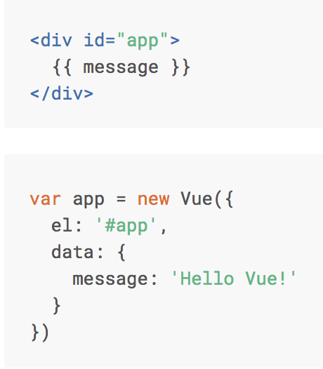

Basics Vue.js

Slide 15
3a
Syntax ReactJS

Slide 16
ReactJS = pure Javascript
classes
Template literals
Arrow functions
No Directives available !

Slide 17
ReactJS = pure Javascript
render() {
return (<div>
{this.state.people.map((person, index) =>
( <p>Hello, {person.name}!</p>
))}
</div>);
}
Hello, Pieter!
Hello, Mark!
Hello, Truus!

Slide 18
3b
Syntax Vue.js

Slide 19
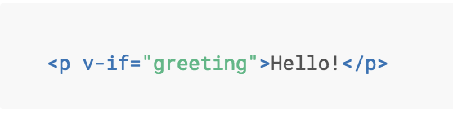
Directive v-if
Notes:
Here, the v-if directive would remove/insert the <p> element based on the truthiness of the value of the expression greeting.

Slide 20
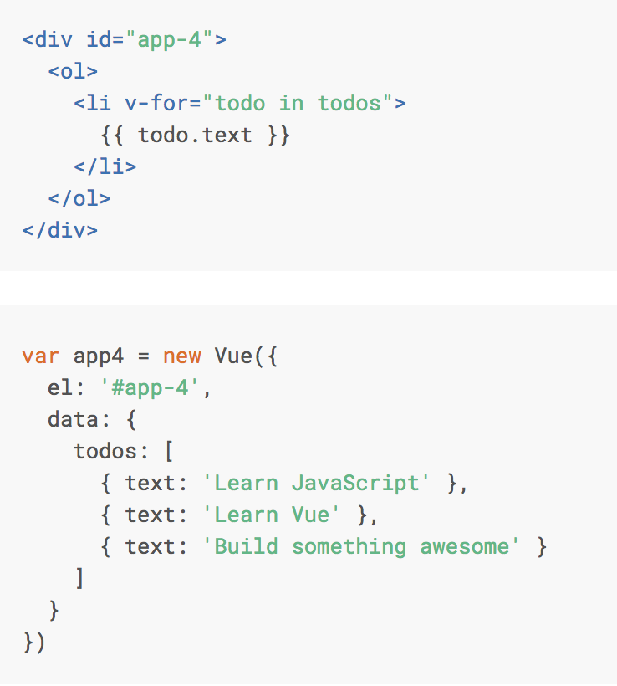
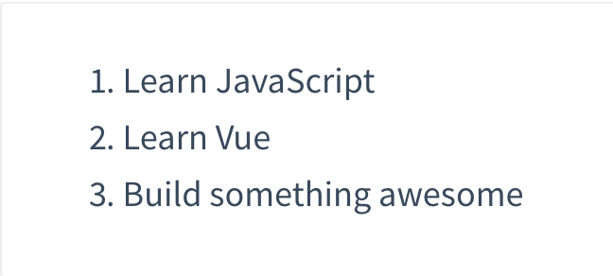
Directive v-for

Slide 21
4a
How do we mutate data?

Slide 22
Changing State ReactJS
Do not! Change state with:
this.state = newState
Use:
this.setState( { … } )

Slide 23

class WelcomeStatefull extends React.Component { constructor(){ super(); this.state = { message: "my friend !" }; } render( ) { return <h1>Hello {this.state.message}</h1>; } }

Slide 24
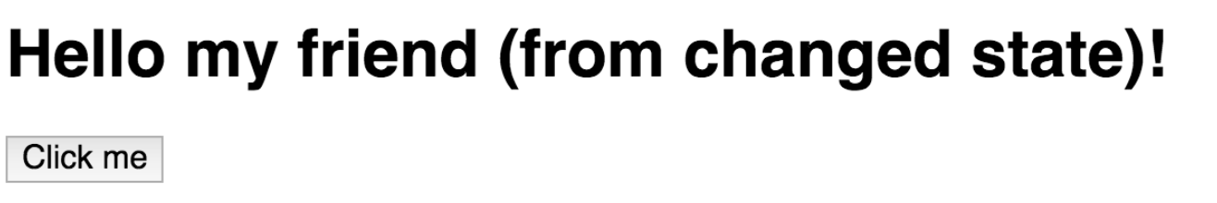
class WelcomeStatefull extends React.Component { constructor(){ super(); this.state = { message: "my friend !" }; this.updateMessage = this.updateMessage.bind(this); }
updateMessage( ) { this.setState({ message: "my friend (from changed state)!" }); }
render( ) { return ( <div> <h1>Hello {this.state.message}!</h1> <button onClick={this.updateMessage}>Click me!</button> </div> ) } }

Slide 25
4b
How do we mutate data?

Slide 26
<template>
<div>Hello {{message }}</div>
<button @click=“changeMessage”></button>
</template>
export default {
name: ‘welcome’,
data ( ) {
message: “Hello”
},
methods: {
changeMessage( ) {
this.message = “Hello everybody !!!”
}
},
}
Hello everybody !!!
Notes:
This is the container component.
The tesla-battery.component: Provides data and actions to child/presentational components.
COMPUTED vs METHODS:
However, the difference is that computed properties are cached based on their dependencies. A computed property will only re-evaluate when some of its dependencies have changed. This means as long as message has not changed, multiple access to the reversedMessage computed property will immediately return the previously computed result without having to run the function again.

Slide 28
Notes:
Component = A function that receives data as input and returns a view.

Slide 29
5
2 way data binding

Slide 31
Notes:
We create a color state in the constructor, this state can be changed with the changeColor function. The changeColor function is going to be passed to the ChildComponent as a prop also named changeColor (or whatever you like).

Slide 32
Pass the callback function
<ChildComponent changeColor={this.changeColor} />

Slide 33
The Child Component
Notes:
We are going to use the changeColor prop in the handleClick arrow function.
The props.changeColor is the changeColor function from ParentComponent. We are going to pass it the value of the clicked button.
https://medium.com/front-end-weekly/tutorial-react-two-way-data-binding-2018-b935cb200964

Slide 35
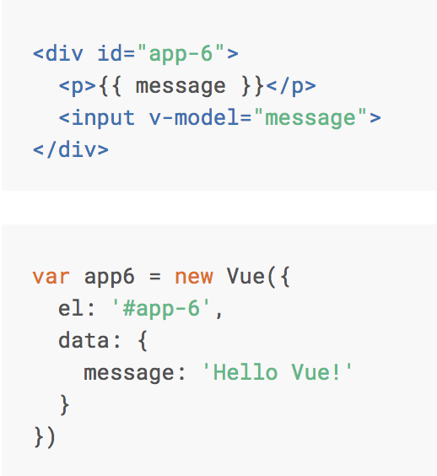
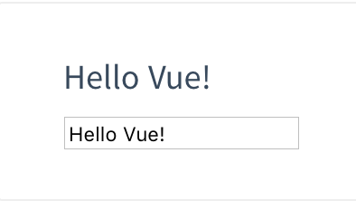
Directive v-model

Slide 36
Components are like JavaScript functions
fn(d) = V
Notes:
Component = A function that receives data as input and returns a view.

